Slide 1
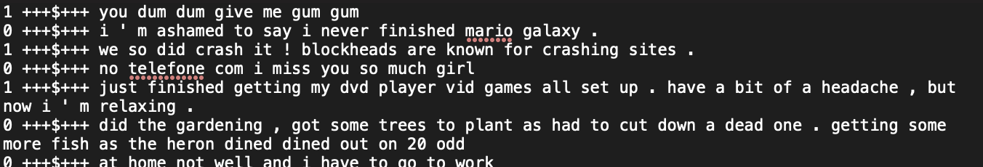
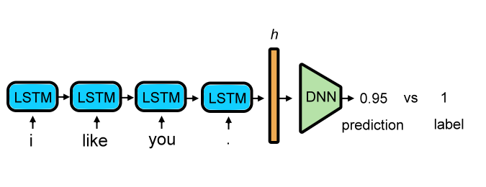
Task - Text Sentiment Classification

Slide 2
Text Sentiment Classification
HW3 make use of reviews from Twitter, which assigned with label positive or negative:
Besides labeled training data, nolabel training data is also provided.
labeled training data ：150000
unlabeled training data ：150000
testing data ：50000（25000 public，25000 private）
1：Positive
0：Negtive

Slide 3
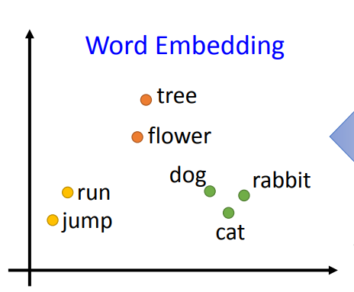
What is Word Embedding
Use a vector to represent the meaning of words
Notes:
nice

Slide 4
Semi-supervised Learning
Semi-supervised simply means that the machine uses unlabeled data, and there are many ways to do this, here is a brief introduction to one of the better methods Self-Training
Self-Training: The train model makes predictions on unlabeled data and converts the predicted values into labels for the unlabeled data, and adds the new data for training. You can adjust different thresholds, or take multiple samples to get more confident data. e.g., set threshold = 0.8 so that only data with prediction > 0.8 will be labeled with 1.

Slide 5
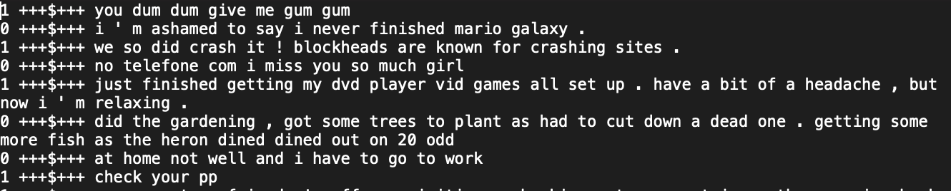
Data Format (labeled data)
label +++$+++ text

Slide 6
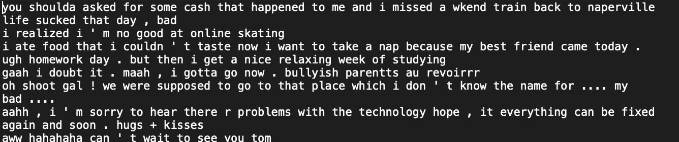
Data Format (unlabeled data)
Text

Slide 7
Hints for better result
Optimizer
Learning rate
Epoch
Batch size
Activation function
Self-Training for unlabel training data

